Slide 1
Week 12B
CPE 487 Digital System Design
Darian Muresan
dmuresan@stevens.edu
© 2020 Stevens Institute of Technology. All Rights Reserved.

Slide 2
Agenda
Submit Final Project Proposals / Descriptions
Project Evaluation
Buffers/Drivers and Pull-Up/Down Resistors
2

Slide 3
Submitted Projects
Traffic Light Logic LED/3D Print - Individual, Vasili Karalewich
I will make a four-road intersection with traffic lights and will add logic to the VGA board to change the green/yellow/red lights. I will display it by using green/yellow/red LED lights and printing traffic poles using a 3D printer.
I will then add a second part that can be scaled up with 120 VAC transistors, so it can be used on a real traffic light. I may also add an additional feature to detect cars at the light.
Traffic Light – Luisa Bonfim, Mitchell Reiff, and I (Peter Shikhman)
Our group will implement a traffic light controller using a finite state machine in VHDL.
We found some example resources online that we will use as inspiration for our implementation in creating our final result for the project.
Tic-Tac-Toe – Riya Shrestha, Rayhan Howlader, Alex Gaskins, Nikola Ciric, Jackie Fang.
We will be using previous project completed by Kevin Wards team as reference when working on this.
3

Slide 4
Project Evaluation Criteria
In presentation and final report, highlight the learning objectives from the syllabus (8 of them).
Extra credit if you develop external hardware, off the board.
Final report and presentation should include:
Block diagrams
Schematics
Logic, workflow, timing, or any other diagrams that help describe the project.
Extra credit: oscilloscope screenshots.
A final presentation in front of the class.
Project will be evaluated by professors and peers
December 8th and December 13th
4

Slide 5
Learning Objectives
Develop technical documentation of a complex digital system using hardware description language and schematic representations and to evaluate the correct function and performance based on simulations of the system.
Apply VHDL entity/architecture modeling to represent component inputs and outputs and also internal signals, variables and operations.
Develop VHDL models of systems using behavioral, structural, and dataflow concepts to describe the internal behavior and/or structure of the design.
Efficiently model a complex digital system as a hierarchy of interconnected components, taking advantage of regularity and component re-use.
Build VHDL models of complex digital circuits suitable for synthesis where the target platform is an FPGA or ASIC logic library, and understand the limitations of VHDL as a synthesis language and know which particular styles of VHDL coding lead to efficient solutions.
Use VHDL to design complex synthesizable state machines using Mealy and/or Moore architectures.
Write test vectors for a digital system and develop a VHDL test-bench to apply these vectors using file-based input/output operations.
Represent and document designs, perform simulations, and synthesize implementations using software tools provided by an FPGA vendor.
5

Slide 6
Outcomes
Program Outcome 1: (Complex Problem Solving)
1.1 The student will be able to efficiently model a complex digital system as a hierarchy of interconnected components, taking advantage of regularity and component reuse.
1.2 The student will be able to apply VHDL entity/architecture modeling to represent component inputs and outputs and also internal signals, variables, and operations.
1.3 The student will be able to develop VHDL models of systems using behavioral, structural, and dataflow concepts to describe the internal behavior and/or structure of the design.
Program Outcome 2: (Design)
2.1 The student will be able to build VHDL models of complex digital circuits suitable for synthesis where the target platform is an FPGA or ASIC logic library.
2.2 The student will be able to use VHDL to design complex synthesizable finite-state machines using Mealy and/or Moore architectures.
2.3 The student will be able to write test vectors for a digital system and develop a VHDL test-bench to apply these vectors using file-based input/output operations.
Program Outcome 3: (Communication)
3.1 The student will be able to develop technical documentation of a complex digital system using hardware description language and schematic representations and to evaluate the correct function and performance based on simulations of the system.
Program Outcome 6: (Experimentation)
1.3 The student will be able to represent and document designs, perform simulations, and synthesize implementations using software tools provided by an FPGA vendor.
6

Slide 7
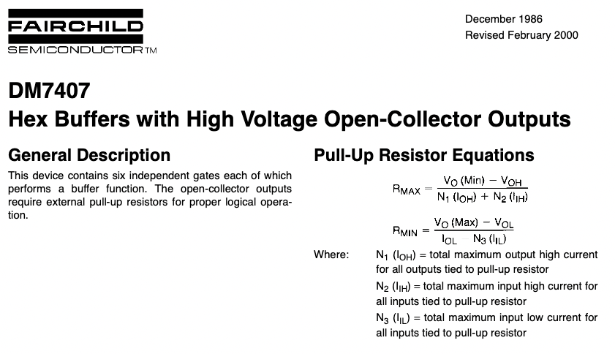
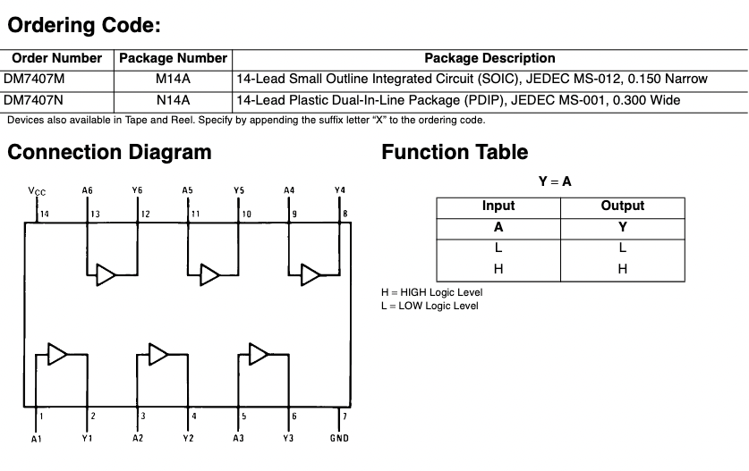
Buffers or Drivers for Off-Board Control – 7407

Slide 8
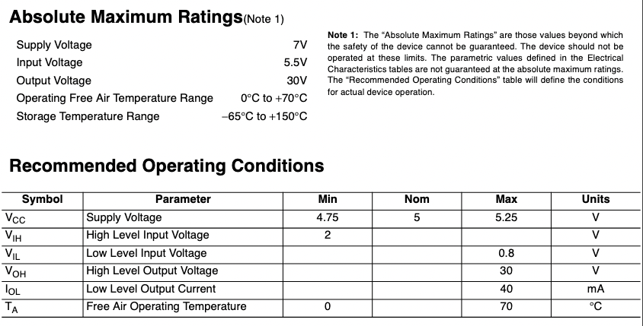
Buffers or Drivers for Off-Board Control – 7407

Slide 9
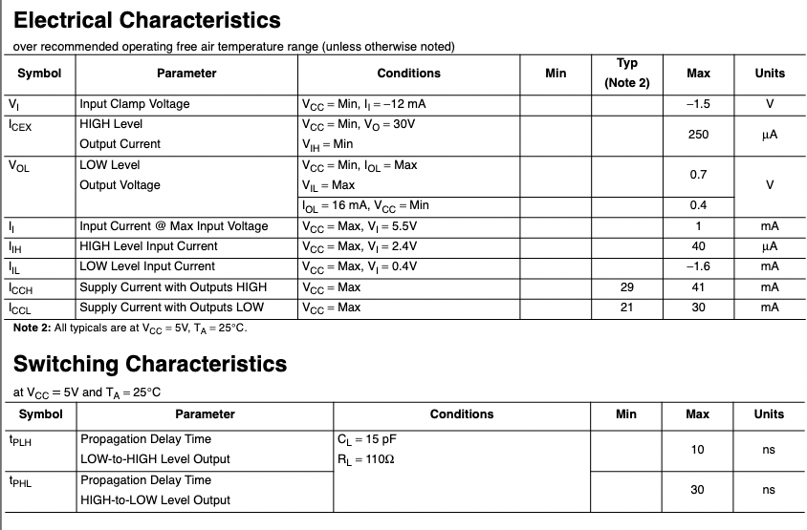
Buffers or Drivers for Off-Board Control – 7407

Slide 10
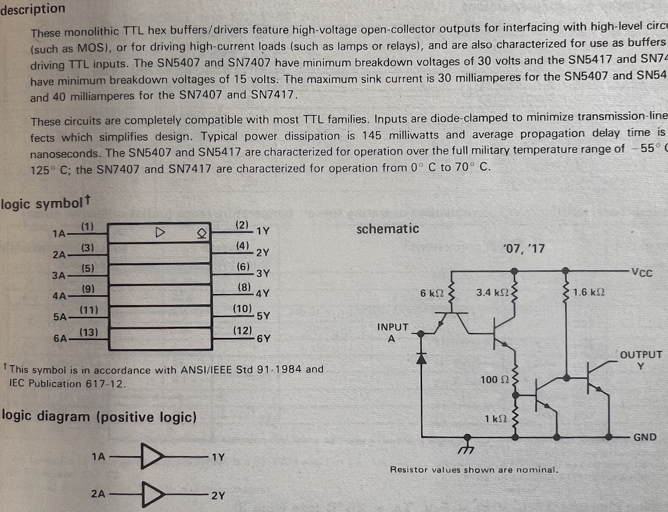
Buffers – 7407

Slide 11
Backup Slides

Slide 12
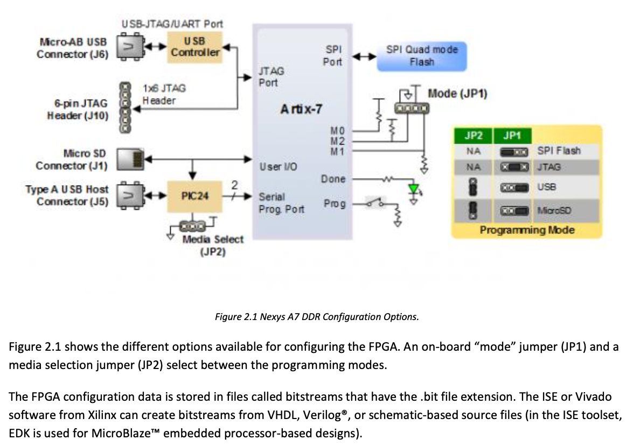
Programming the FPGA
12

Slide 13
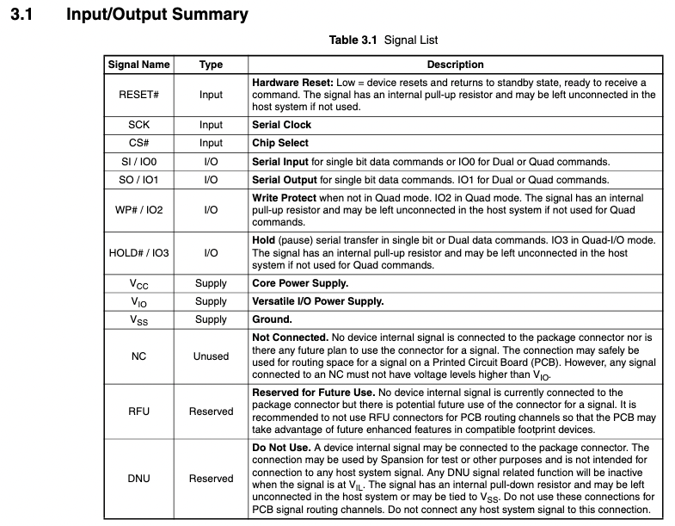
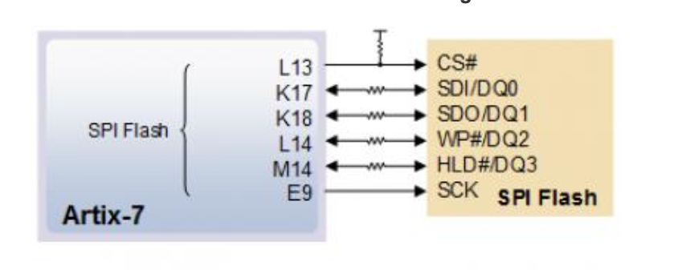
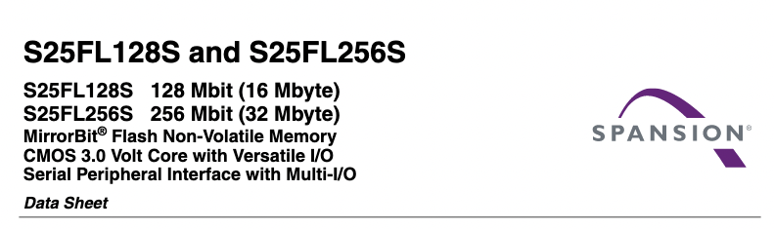
Programming the FPGA
13

Slide 14
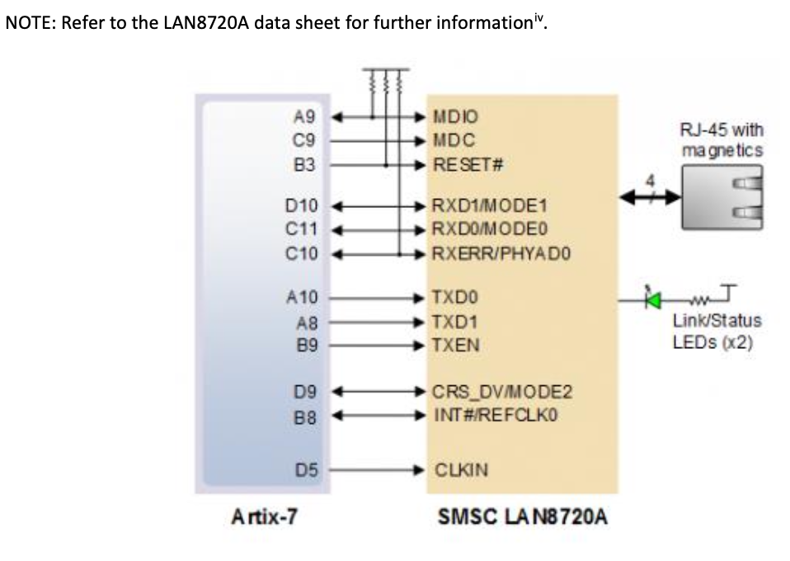
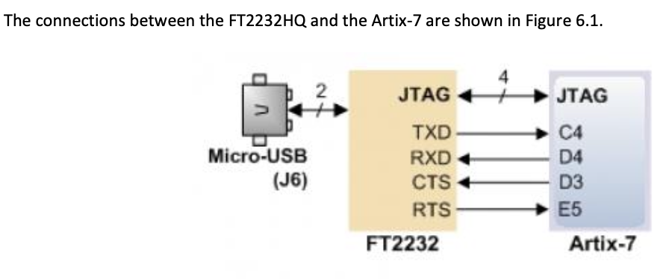
The FPGA Data Connection
14

